Slide 1
Decision Tree and Random Forest

Slide 2
Decision Tree Regression:
Decision Tree is a supervised learning algorithm which can be used for solving both classification and regression problems.
It can solve problems for both categorical and numerical data.
Decision Tree regression builds a tree-like structure in which each internal node represents the "test" for an attribute, each branch represent the result of the test, and each leaf node represents the final decision or result.
A decision tree is constructed starting from the root node/parent node (dataset), which splits into left and right child nodes (subsets of dataset). These child nodes are further divided into their children node, and themselves become the parent node of those nodes.

Slide 3
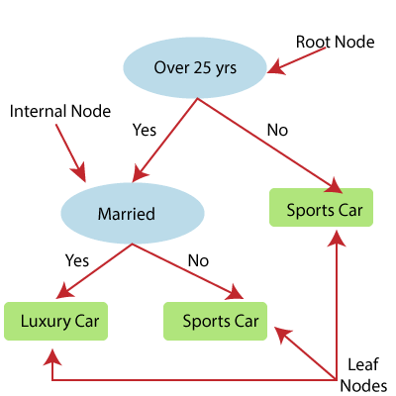
Above image showing the example of Decision Tee regression, here, the model is trying to predict the choice of a person between Sports cars or Luxury car.
Random forest is one of the most powerful supervised learning algorithms which is capable of performing regression as well as classification tasks.
The Random Forest regression is an ensemble learning method which combines multiple decision trees and predicts the final output based on the average of each tree output.
The combined decision trees are called as base models, and it can be represented more formally as:
g(x)= f0(x)+ f1(x)+ f2(x)+....

Slide 4
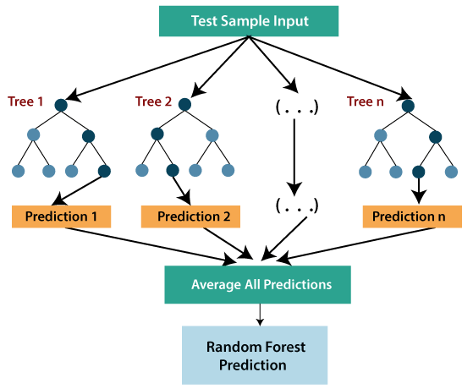

Slide 5
import numpy as np
import matplotlib.pyplot as plt
import pandas as pd
dataset = np.array(
[['Asset Flip', 100, 1000],
['Text Based', 500, 3000],
['Visual Novel', 1500, 5000],
['2D Pixel Art', 3500, 8000],
['2D Vector Art', 5000, 6500],
['Strategy', 6000, 7000],
['First Person Shooter', 8000, 15000],
['Simulator', 9500, 20000],
['Racing', 12000, 21000],
['RPG', 14000, 25000],
['Sandbox', 15500, 27000],
['Open-World', 16500, 30000],
['MMOFPS', 25000, 52000],
['MMORPG', 30000, 80000]
])
print(dataset)

Slide 6
Step 3: Select all the rows and column 1 from the dataset to “X”.
X = dataset[:, 1:2].astype(int)
print(X)
Step 4: Select all of the rows and column 2 from the dataset to “y”.
y = dataset[:, 2].astype(int)
print(y)
Step 5: Fit decision tree regressor to the dataset
from sklearn.tree import DecisionTreeRegressor
regressor = DecisionTreeRegressor(random_state = 0)
regressor.fit(X, y)
Step 6: Predicting a new value
y_pred = regressor.predict([[3750]])
print("Predicted price: % d\n"% y_pred)

Slide 7
Step 7: Visualising the result
X_grid = np.arange(min(X), max(X), 0.01)
X_grid = X_grid.reshape((len(X_grid), 1))
plt.scatter(X, y, color = 'red')
plt.plot(X_grid, regressor.predict(X_grid), color = 'blue')
plt.title('Profit to Production Cost (Decision Tree Regression)')
plt.xlabel('Production Cost')
plt.ylabel('Profit')
plt.show()

Slide 8
import numpy as np
import pandas as pd
from sklearn.model_selection import train_test_split
from sklearn.ensemble import RandomForestClassifier
from sklearn.metrics import classification_report, confusion_matrix, accuracy_score
path = "https://archive.ics.uci.edu/ml/machine-learning-databases/iris/iris.data"
headernames = ['sepal-length', 'sepal-width', 'petal-length', 'petal-width', 'Class']
dataset = pd.read_csv(path, names = headernames)
X = dataset.iloc[:, :-1].values
y = dataset.iloc[:, 4].values
X_train, X_test, y_train, y_test = train_test_split(X, y, test_size=0.30)
RFclf = RandomForestClassifier(n_estimators = 50)

Slide 9
RFclf.fit(X_train, y_train)
y_pred = RFclf.predict(X_test)
result = confusion_matrix(y_test, y_pred)
print("Confusion Matrix:")
print(result)
result1 = classification_report(y_test, y_pred)
print("Classification Report:",)
print (result1)
result2 = accuracy_score(y_test,y_pred)
print("Accuracy:",result2)

Slide 10
%matplotlib inline
import matplotlib.pyplot as plt
import seaborn as sns; sns.set()
import numpy as np
from sklearn.cluster import KMeans
from sklearn.datasets import load_digits
digits = load_digits()
digits.data.shape
kmeans = KMeans(n_clusters = 10, random_state = 0)
clusters = kmeans.fit_predict(digits.data)
kmeans.cluster_centers_.shape

Slide 11
Decision tree
Decision Tree is a Supervised learning technique that can be used for both classification and Regression problems, but mostly it is preferred for solving Classification problems.
It is a tree-structured classifier, where internal nodes represent the features of a dataset, branches represent the decision rules and each leaf node represents the outcome.
In a Decision tree, there are two nodes, which are the Decision Node and Leaf Node.
Decision nodes are used to make any decision and have multiple branches, whereas Leaf nodes are the output of those decisions and do not contain any further branches.
The decisions or the test are performed on the basis of features of the given dataset.
It is a graphical representation for getting all the possible solutions to a problem/decision based on given conditions.

Slide 12

It is called a decision tree because, similar to a tree, it starts with the root node, which expands on further branches and constructs a tree-like structure.
In order to build a tree, we use the CART algorithm, which stands for Classification and Regression Tree algorithm.
A decision tree simply asks a question, and based on the answer (Yes/No), it further split the tree into subtrees.

Slide 13
Why use Decision Trees?
There are various algorithms in Machine learning, so choosing the best algorithm for the given dataset and problem is the main point to remember while creating a machine learning model. Below are the two reasons for using the Decision tree:
Decision Trees usually mimic human thinking ability while making a decision, so it is easy to understand.
The logic behind the decision tree can be easily understood because it shows a tree-like structure.

Slide 14
Decision Tree Terminologies
Root Node: Root node is from where the decision tree starts. It represents the entire dataset, which further gets divided into two or more homogeneous sets.
Leaf Node: Leaf nodes are the final output node, and the tree cannot be segregated further after getting a leaf node.
Splitting: Splitting is the process of dividing the decision node/root node into sub-nodes according to the given conditions.
Branch/Sub Tree: A tree formed by splitting the tree.
Pruning: Pruning is the process of removing the unwanted branches from the tree.
Parent/Child node: The root node of the tree is called the parent node, and other nodes are called the child nodes.

Slide 15
How does the Decision Tree algorithm Work?
In a decision tree, for predicting the class of the given dataset, the algorithm starts from the root node of the tree.
This algorithm compares the values of root attribute with the record (real dataset) attribute and, based on the comparison, follows the branch and jumps to the next node.
For the next node, the algorithm again compares the attribute value with the other sub-nodes and move further. It continues the process until it reaches the leaf node of the tree.

Slide 16
Step-1: Begin the tree with the root node, says S, which contains the complete dataset.
Step-2: Find the best attribute in the dataset using Attribute Selection Measure (ASM).
Step-3: Divide the S into subsets that contains possible values for the best attributes.
Step-4: Generate the decision tree node, which contains the best attribute.
Step-5: Recursively make new decision trees using the subsets of the dataset created in step -3. Continue this process until a stage is reached where you cannot further classify the nodes and called the final node as a leaf node.

Slide 17
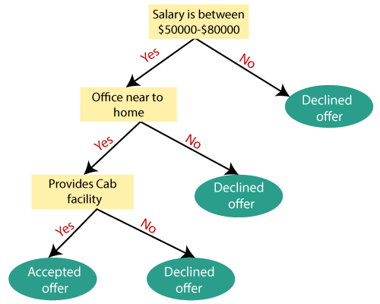
Example: Suppose there is a candidate who has a job offer and wants to decide whether he should accept the offer or Not.
So, to solve this problem, the decision tree starts with the root node (Salary attribute by ASM).
The root node splits further into the next decision node (distance from the office) and one leaf node based on the corresponding labels.
The next decision node further gets split into one decision node (Cab facility) and one leaf node.
Finally, the decision node splits into two leaf nodes (Accepted offers and Declined offer).

Slide 18
Attribute Selection Measures
While implementing a Decision tree, the main issue arises that how to select the best attribute for the root node and for sub-nodes.
So, to solve such problems there is a technique which is called as Attribute selection measure or ASM.
By this measurement, we can easily select the best attribute for the nodes of the tree.
There are two popular techniques for ASM, which are:
Information Gain
Gini Index
Information Gain:
Information gain is the measurement of changes in entropy after the segmentation of a dataset based on an attribute.
It calculates how much information a feature provides us about a class.
According to the value of information gain, we split the node and build the decision tree.
A decision tree algorithm always tries to maximize the value of information gain, and a node/attribute having the highest information gain is split first. It can be calculated using the below formula:
Information Gain= Entropy(S)- [(Weighted Avg) *Entropy(each feature)

Slide 19
Gini Index
Gini index is a measure of impurity or purity used while creating a decision tree in the CART(Classification and Regression Tree) algorithm.
An attribute with the low Gini index should be preferred as compared to the high Gini index.
It only creates binary splits, and the CART algorithm uses the Gini index to create binary splits.
Gini index can be calculated using the below formula:
Gini Index= 1- ∑jPj2
Pruning: Getting an Optimal Decision tree
Pruning is a process of deleting the unnecessary nodes from a tree in order to get the optimal decision tree.
A too-large tree increases the risk of overfitting, and a small tree may not capture all the important features of the dataset.
Therefore, a technique that decreases the size of the learning tree without reducing accuracy is known as Pruning. There are mainly two types of tree pruning technology used:
Cost Complexity Pruning
Reduced Error Pruning

Slide 20
Advantages of the Decision Tree
It is simple to understand as it follows the same process which a human follow while making any decision in real-life.
It can be very useful for solving decision-related problems.
It helps to think about all the possible outcomes for a problem.
There is less requirement of data cleaning compared to other algorithms.
Disadvantages of the Decision Tree
The decision tree contains lots of layers, which makes it complex.
It may have an overfitting issue, which can be resolved using the Random Forest algorithm.
For more class labels, the computational complexity of the decision tree may increase.

Slide 21
Implementation of Decision Tree
Data Pre-Processing Step:
import numpy as nm
import matplotlib.pyplot as mtp
import pandas as pd
data_set= pd.read_csv(‘tips.csv')
x= data_set.iloc[:, [0,1]].values
y= data_set.iloc[:, 1].values
from sklearn.model_selection import train_test_split
x_train, x_test, y_train, y_test= train_test_split(x, y, test_size= 0.25, random_state=0)
from sklearn.preprocessing import StandardScaler
st_x= StandardScaler()
x_train= st_x.fit_transform(x_train)
x_test= st_x.transform(x_test)

Slide 22
Fitting a Decision-Tree algorithm to the Training set
Now we will fit the model to the training set. For this, we will import the DecisionTreeClassifier class from sklearn.tree library.
from sklearn.tree import DecisionTreeClassifier
classifier= DecisionTreeClassifier(criterion='entropy', random_state=0)
classifier.fit(x_train, y_train)
we have created a classifier object, in which we have passed two main parameters;
"criterion='entropy': Criterion is used to measure the quality of split, which is calculated by information gain given by entropy.
random_state=0": For generating the random states.

Slide 23
Predicting the test result
Now we will predict the test set result. We will create a new prediction vector y_pred. Below is the code for it:
y_pred= classifier.predict(x_test)
Test accuracy of the result (Creation of Confusion matrix)
We have seen that there were some incorrect predictions, so if we want to know the number of correct and incorrect predictions, we need to use the confusion matrix.
from sklearn.metrics import confusion_matrix
cm= confusion_matrix(y_test, y_pred)

Slide 24
Visualizing the training set result:
Here we will visualize the training set result. To visualize the training set result we will plot a graph for the decision tree classifier. The classifier will predict yes or No for the users who have either Purchased or Not purchased the SUV car as we did in Logistic Regression.
from matplotlib.colors import ListedColormap
x_set, y_set = x_train, y_train
x1, x2 = nm.meshgrid(nm.arange(start = x_set[:, 0].min() - 1, stop = x_set[:, 0].max() + 1, step =0.01),
nm.arange(start = x_set[:, 1].min() - 1, stop = x_set[:, 1].max() + 1, step = 0.01))
mtp.contourf(x1, x2, classifier.predict(nm.array([x1.ravel(), x2.ravel()]).T).reshape(x1.shape),
alpha = 0.75, cmap = ListedColormap(('purple','green' )))
mtp.xlim(x1.min(), x1.max())
mtp.ylim(x2.min(), x2.max())
fori, j in enumerate(nm.unique(y_set)):

Slide 25
mtp.scatter(x_set[y_set == j, 0], x_set[y_set == j, 1],
c = ListedColormap(('purple', 'green'))(i), label = j)
mtp.title('Decision Tree Algorithm (Training set)')
mtp.xlabel(‘Total Bill')
mtp.ylabel(‘Tips')
mtp.legend()
mtp.show()

Slide 26
Visulaizing the test set result
from matplotlib.colors import ListedColormap
x_set, y_set = x_test, y_test
x1, x2 = nm.meshgrid(nm.arange(start = x_set[:, 0].min() - 1, stop = x_set[:, 0].max() + 1, step =0.01),
nm.arange(start = x_set[:, 1].min() - 1, stop = x_set[:, 1].max() + 1, step = 0.01))
mtp.contourf(x1, x2, classifier.predict(nm.array([x1.ravel(), x2.ravel()]).T).reshape(x1.shape),
alpha = 0.75, cmap = ListedColormap(('purple','green' )))
mtp.xlim(x1.min(), x1.max())
mtp.ylim(x2.min(), x2.max())
fori, j in enumerate(nm.unique(y_set)):
mtp.scatter(x_set[y_set == j, 0], x_set[y_set == j, 1],
c = ListedColormap(('purple', 'green'))(i), label = j)
mtp.title('Decision Tree Algorithm(Test set)')
mtp.xlabel('Age')
mtp.ylabel('Estimated Salary')
mtp.legend()
mtp.show()

Slide 27
import numpy as nm
import matplotlib.pyplot as mtp
import pandas as pd
data_set= pd.read_csv('user_data.csv')
x= data_set.iloc[:, [2,3]].values
y= data_set.iloc[:, 4].values
from sklearn.model_selection import train_test_split
x_train, x_test, y_train, y_test= train_test_split(x, y, test_size= 0.25, random_state=0)
from sklearn.preprocessing import StandardScaler
st_x= StandardScaler()
x_train= st_x.fit_transform(x_train)
x_test= st_x.transform(x_test)

Slide 28
#Fitting Decision Tree classifier to the training set
from sklearn.ensemble import RandomForestClassifier
classifier= RandomForestClassifier(n_estimators= 10, criterion="entropy")
classifier.fit(x_train, y_train)
n_estimators= The required number of trees in the Random Forest. The default value is 10. We can choose any number but need to take care of the overfitting issue.
criterion= It is a function to analyze the accuracy of the split. Here we have taken "entropy" for the information gain.
#Predicting the test set result
y_pred= classifier.predict(x_test)
#Creating the Confusion matrix
from sklearn.metrics import confusion_matrix
cm= confusion_matrix(y_test, y_pred)

Slide 29
from matplotlib.colors import ListedColormap
x_set, y_set = x_train, y_train
x1, x2 = nm.meshgrid(nm.arange(start = x_set[:, 0].min() - 1, stop = x_set[:, 0].max() + 1, step =0.01),
nm.arange(start = x_set[:, 1].min() - 1, stop = x_set[:, 1].max() + 1, step = 0.01))
mtp.contourf(x1, x2, classifier.predict(nm.array([x1.ravel(), x2.ravel()]).T).reshape(x1.shape),
alpha = 0.75, cmap = ListedColormap(('purple','green' )))
mtp.xlim(x1.min(), x1.max())
mtp.ylim(x2.min(), x2.max())
for i, j in enumerate(nm.unique(y_set)):
mtp.scatter(x_set[y_set == j, 0], x_set[y_set == j, 1],
c = ListedColormap(('purple', 'green'))(i), label = j)
mtp.title('Random Forest Algorithm (Training set)')
mtp.xlabel(‘Total Bill)
mtp.ylabel(‘Tips')
mtp.legend()
mtp.show()

Slide 30
import numpy as nm
import matplotlib.pyplot as mtp
import pandas as pd
data_set= pd.read_csv('user_data.csv')
x= data_set.iloc[:, [2,3]].values
y= data_set.iloc[:, 4].values
from sklearn.model_selection import train_test_split
x_train, x_test, y_train, y_test= train_test_split(x, y, test_size= 0.25, random_state=0)
from sklearn.preprocessing import StandardScaler
st_x= StandardScaler()
x_train= st_x.fit_transform(x_train)
x_test= st_x.transform(x_test)

Slide 31
#Fitting Decision Tree classifier to the training set
from sklearn.ensemble import RandomForestClassifier
classifier= RandomForestClassifier(n_estimators= 10, criterion="entropy")
classifier.fit(x_train, y_train)
#Creating the Confusion matrix
from sklearn.metrics import confusion_matrix
cm= confusion_matrix(y_test, y_pred)

Slide 32
from matplotlib.colors import ListedColormap
x_set, y_set = x_train, y_train
x1, x2 = nm.meshgrid(nm.arange(start = x_set[:, 0].min() - 1, stop = x_set[:, 0].max() + 1, step =0.01),
nm.arange(start = x_set[:, 1].min() - 1, stop = x_set[:, 1].max() + 1, step = 0.01))
mtp.contourf(x1, x2, classifier.predict(nm.array([x1.ravel(), x2.ravel()]).T).reshape(x1.shape),
alpha = 0.75, cmap = ListedColormap(('purple','green' )))
mtp.xlim(x1.min(), x1.max())
mtp.ylim(x2.min(), x2.max())
for i, j in enumerate(nm.unique(y_set)):
mtp.scatter(x_set[y_set == j, 0], x_set[y_set == j, 1],
c = ListedColormap(('purple', 'green'))(i), label = j)
mtp.title('Random Forest Algorithm (Training set)')
mtp.xlabel(‘Total Bill’)
mtp.ylabel(‘Tips')
mtp.legend()
mtp.show()

Slide 33
from matplotlib.colors import ListedColormap
x_set, y_set = x_test, y_test
x1, x2 = nm.meshgrid(nm.arange(start = x_set[:, 0].min() - 1, stop = x_set[:, 0].max() + 1, step =0.01),
nm.arange(start = x_set[:, 1].min() - 1, stop = x_set[:, 1].max() + 1, step = 0.01))
mtp.contourf(x1, x2, classifier.predict(nm.array([x1.ravel(), x2.ravel()]).T).reshape(x1.shape),
alpha = 0.75, cmap = ListedColormap(('purple','green' )))
mtp.xlim(x1.min(), x1.max())
mtp.ylim(x2.min(), x2.max())
for i, j in enumerate(nm.unique(y_set)):
mtp.scatter(x_set[y_set == j, 0], x_set[y_set == j, 1],
c = ListedColormap(('purple', 'green'))(i), label = j)
mtp.title('Random Forest Algorithm(Test set)')
mtp.xlabel(‘Total Bill')
mtp.ylabel(‘Tips')
mtp.legend()
mtp.show()

Slide 34
Random Forest Algorithm
Random Forest is a popular machine learning algorithm that belongs to the supervised learning technique. It can be used for both Classification and Regression problems in ML.
It is based on the concept of ensemble learning, which is a process of combining multiple classifiers to solve a complex problem and to improve the performance of the model.
As the name suggests, "Random Forest is a classifier that contains a number of decision trees on various subsets of the given dataset and takes the average to improve the predictive accuracy of that dataset."
Instead of relying on one decision tree, the random forest takes the prediction from each tree and based on the majority votes of predictions, and it predicts the final output
The greater number of trees in the forest leads to higher accuracy and prevents the problem of overfitting.

Slide 35
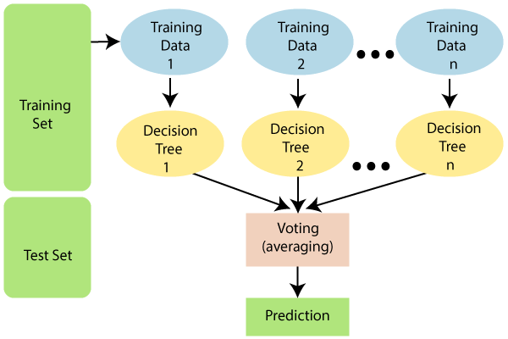

Slide 36
Assumptions for Random Forest
Since the random forest combines multiple trees to predict the class of the dataset, it is possible that some decision trees may predict the correct output, while others may not.
But together, all the trees predict the correct output. Therefore, below are two assumptions for a better Random forest classifier:
There should be some actual values in the feature variable of the dataset so that the classifier can predict accurate results rather than a guessed result.
The predictions from each tree must have very low correlations.

Slide 37
Why use Random Forest?
Below are some points that explain why we should use the Random Forest algorithm:
It takes less training time as compared to other algorithms.
It predicts output with high accuracy, even for the large dataset it runs efficiently.
It can also maintain accuracy when a large proportion of data is missing.

Slide 38
How does Random Forest algorithm work?
Random Forest works in two-phase first is to create the random forest by combining N decision tree, and second is to make predictions for each tree created in the first phase.
The Working process can be explained in the below steps and diagram:
Step-1: Select random K data points from the training set.
Step-2: Build the decision trees associated with the selected data points (Subsets).
Step-3: Choose the number N for decision trees that you want to build.
Step-4: Repeat Step 1 & 2.

Slide 39
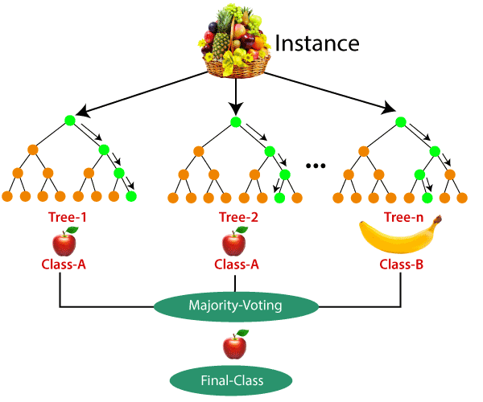
Step-5: For new data points, find the predictions of each decision tree, and assign the new data points to the category that wins the majority votes.
Example:
Suppose there is a dataset that contains multiple fruit images.
So, this dataset is given to the Random forest classifier.
The dataset is divided into subsets and given to each decision tree.
During the training phase, each decision tree produces a prediction result, and when a new data point occurs, then based on the majority of results, the Random Forest classifier predicts the final decision. Consider the below image:

